Slide 1
Project presentation
Topic: Fractional Fourier neural operator on partial differential equations
Student: Suwei Yang
Advisor: Shandian Zhe

Slide 2
Improvement list
P4 part by part to show
P.6 v to t
P6 add fno wno title
P11 express high freq and non stationary
Explain dataset number, at result
Numerical generation
Burger’s v=0 valid or not it is valid! It is called inviscid burger
Wave’s v valid or not
Fixed model architecture

Slide 3
Outline
Problem definition
Motivation
What did I do?
Result
Conclusion

Slide 4
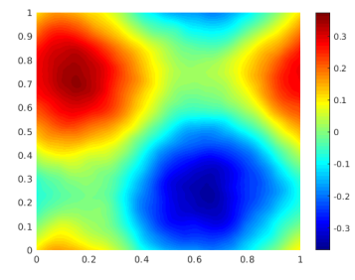
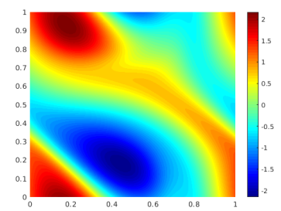
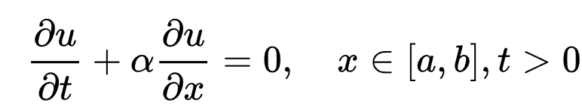


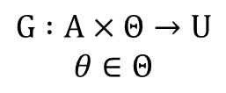

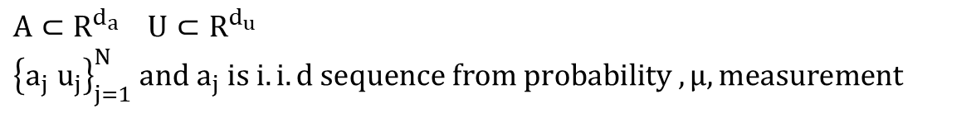




Problem definition
After t
$$a= u\left(x,0\right)$$
$$u=u(x,t)$$
Nonlinear map
$$G^{†} : A→U$$
Goal
$$G_{θ }: A→U$$
Observation
$A⊂R^{d_{a}} U⊂R^{d_{u}}$
${\left\{a_{j} u_{j}\right\}}_{j=1}^{N} and a_{j} is i.i.d sequence from probability ,μ, measurement$
Method
$$G :A×Θ→U$$
$$θ∈Θ$$
$$\min_{θ∈Θ}{E_{a\sim μ}[cost(G_{θ }\left(a,θ\right),G^{†}(a))]}$$
Ref: Fourier Neural Operator for Parametric Partial Differential Equations
Notes:
People usually solve pde by numerical method, which is slow. (given boundary, initial condition, constant…)
Turn pde problem into mapping problem, and use neural network to solve it.
Reason: faster
G+: operator maps initial condition to solution (ground truth operator)
G_theta: operator maps initial condition to solution (trained operator)
Observed: get a initial condition and solution( state after t ticks), each pair of them are iid, and include noise
Method: minimize cost function to let G_theta get close to G+

Slide 5

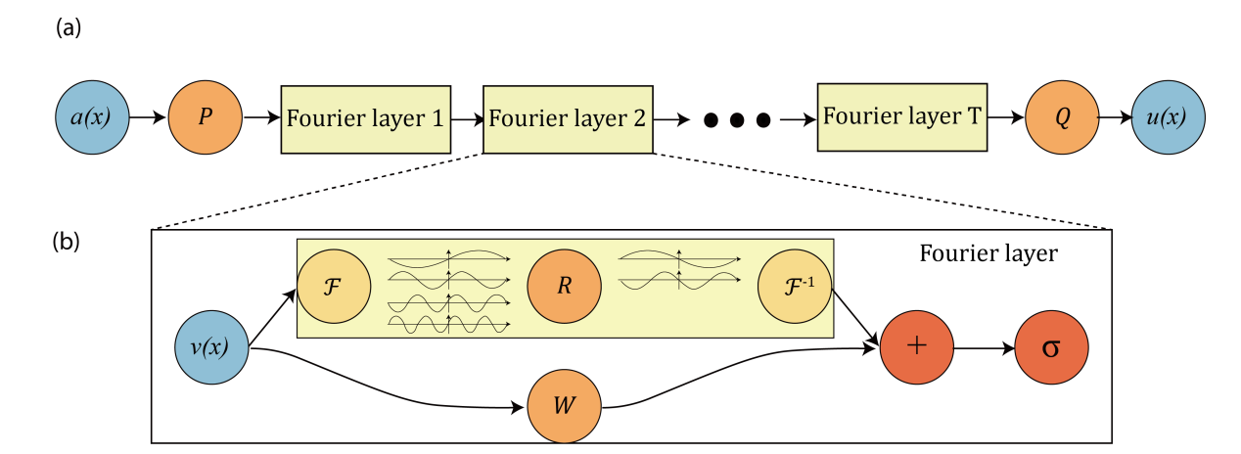
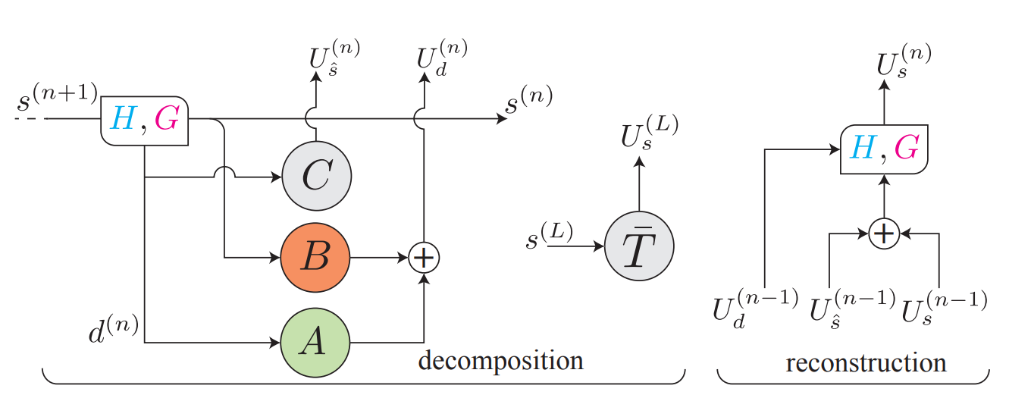



Problem definition
People have done…
Comparison:
FNO:
Fast
No time information
WNO:
Slow
With time information
Fourier transform(FNO)
Wavelet transform (WNO)
frequency
frequency
Abandoned
Important
Important
t
t
amp
amp
Fractional Fourier transform
(FRFT)
Ref: Fourier Neural Operator for Parametric Partial Differential Equations
Multiwavelet-based Operator Learning for Differential Equations
Notes:
2020, FNO was presented,
Benefits: fast, simple
Drawback: no time information
They built Fourier layer and truncated high frequency data. It is efficient, simple, and effective to low frequency, stationary dataset.
Flow: project input to high dimension->turn to foruier domain->truncate dataset->learn the wegith->turn to regular domain->project to regular dimension
2021, WNO was presented,
Benefits: has time information
Drawback: slow
They apply wavelet transform, which include frequency and time information at the same time, but it is pretty slow.
It use filters to divide signal into low frequency and high frequency part.
Learn weights for each part.
Further divide high frequency part into low frequency and high frequency part.
Learn weights for each part.
And so on.
FRFT: A way to combine both benefits:

Slide 6
Outline
Problem definition
Motivation
What did I do?
Result
Conclusion

Slide 7



Motivation
frequency
frequency
Abandoned
Important
Important
t
t
amp
amp
FNO
WNO
frequency
FRFT
Blind area +
Lose high-frequency information
frequency
noise
Signal
frequency
noise
Signal
Time complexity:
O(L*N)+
Wavelet options
Time complexity:
O(NlogN)
t
Important
t
t
amp
Blind area
amp
amp
Ref: Optimal Filtering in Fractional Fourier Domains
Notes:
FNO:
Not able to see frequency and time information at once.
Truncation loses high frequency information
WNO:
Wavelet transform complexity: O(L*N) where L are layers for filters and N is the signal length
Depend on how fine the information we want we need that much layers
It also needs to know what wavelet needed for current dataset. (too many wavelet options to pick)
FRFT:
Draw a line to project the signal on the line in frequency-time plane. (get frequency time information at once)
The time complexity is NlogN

Slide 8
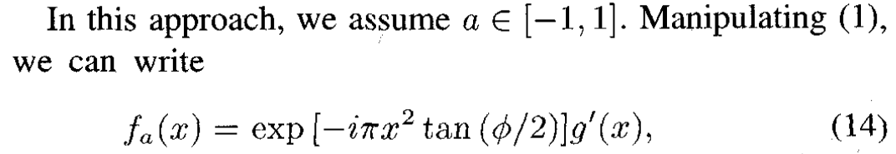

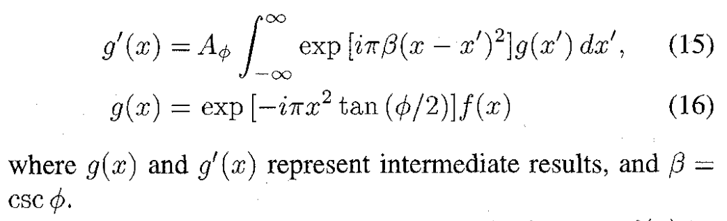
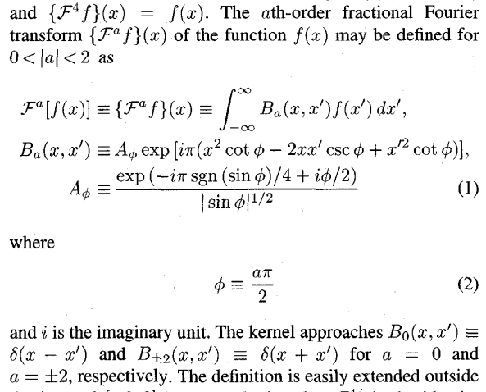

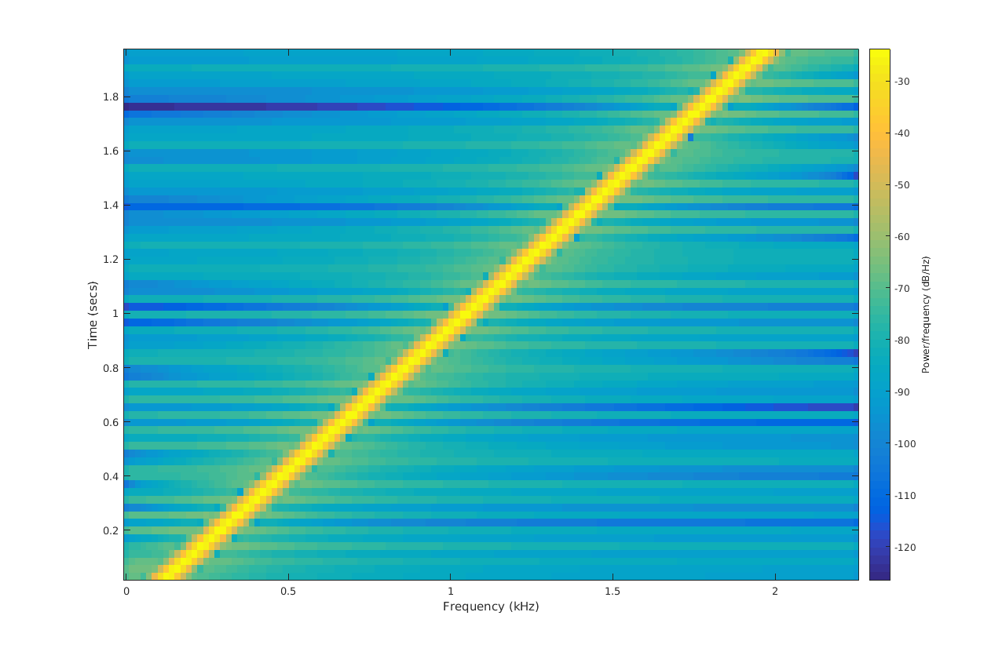
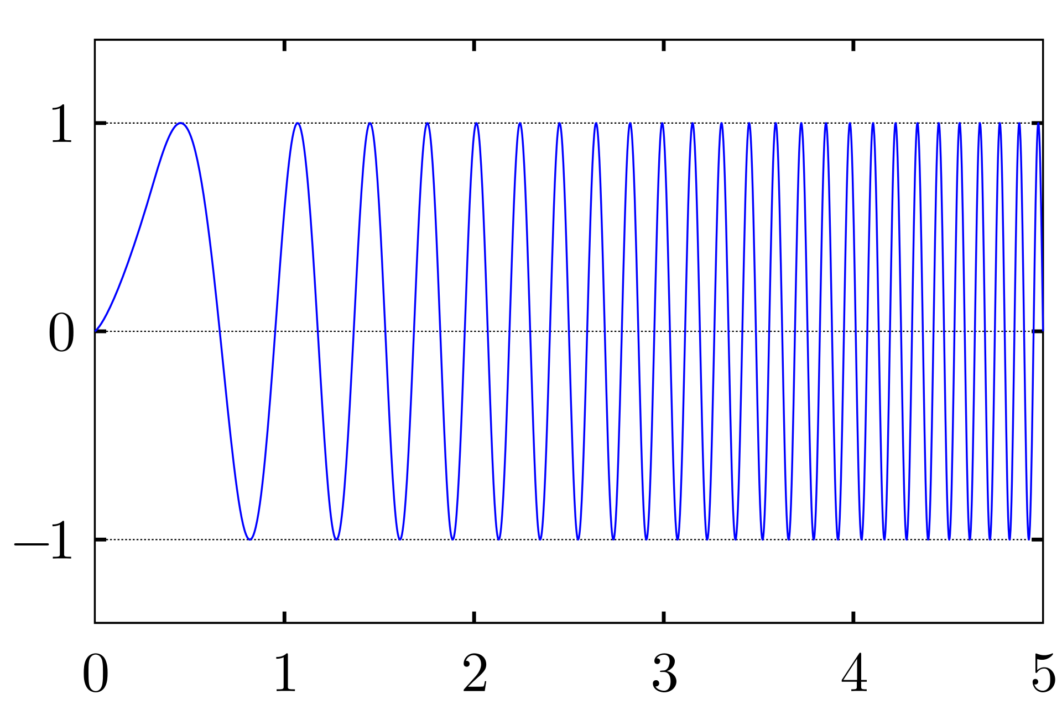
Motivation
frequency
noise
Signal
v
amp
$$Signal_{α}=Chirp ∗Conv(Chirp, Chirp∗signal_{t})$$
Time Complexity: NlogN
frequency
Chirp signal
Ref: Optimal Filtering in Fractional Fourier Domains
Digital Computation of the Fractional Fourier Transform
t
amp
Notes:
Right side: original expression of FRFT, hard to compute
Left side: Fast transform of FRFT, nlogn time complexity
Chirp signal is a signal which frequency varies by variable( like time or space)

Slide 9
Outline
Problem definition
Motivation
What did I do?
Result
Conclusion

Slide 10

What did I do?
frequency
Signal
noise
v
amp
Find cases
High-frequency + Non-stationary dataset
Prove it works
Applying FRFT to it
Notes:
Two things to do:
Produce cases
Prove it work

Slide 11
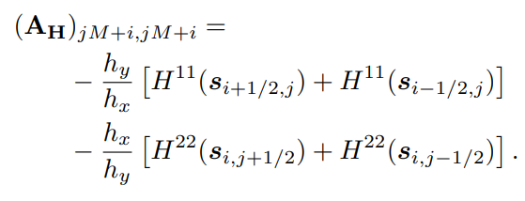
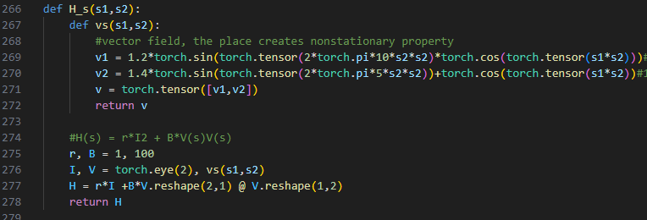
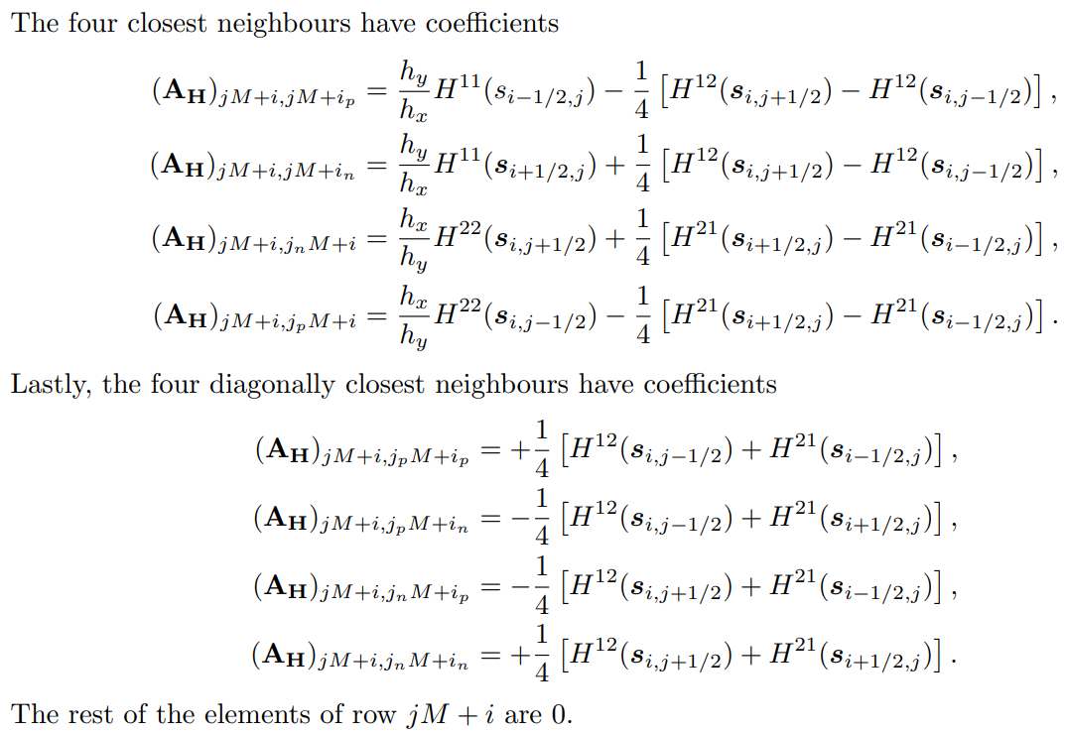


What did I do?
frequency
Signal
noise
v
amp
Find cases
High-frequency + Non-stationary dataset
Prove it works
Applying FRFT to it
$$u\left(s\right)∝\exp\left(−\frac{1}{2}s^{T}Qs\right)$$
$$Q=A^{T}D_{v}A$$
$$A=D_{v}D_{k^{2}}−A_{H}$$
$$A_{H}{∈R}^{MN×MN}$$
When H(s) is a constant,
u(s) is a stationary dataset.
When H(s) has vector fields,
u(s) is a non-stationary dataset.
$$\left(k^{2}−∇H(s)∇\right)u\left(s\right)=W\left(s\right)$$
$$k>0, s∈D=\left[A_{1},B_{1}\right]×\left[A_{2},B_{2}\right] ⊂R^{2},$$
$$∇ =[\frac{∂ }{∂s_{1}},\frac{∂ }{∂s_{2}}]$$
$$H\left(s\right)=function with vector field,$$
$$u\left(s\right)=nonstationary dataset,$$
$$W\left(s\right)=standard gaussian white noise$$
$$H\left(s\right)=γI_{2}+Βv\left(s\right)v{\left(s\right)}^{T},γ,Β>0$$
Ref: Exploring a New Class of Non-stationary Spatial Gaussian Random Fields with Varying Local Anisotropy
Notes:
Build high-freq + non-stationary dataset
High-freq: add low freq data and high freq data (easy)
Nonstaionary: using pde to produce.
Left side:
Multiply inverse matrix in the bracket with white noise to get nonstationary dataset.
There are vector fields in the matrix, which make high-freq and nonstationary property.
Middle side:
Produce stationary dataset when vector field is a constant
Produce nonstationary dataset when vector filed is a function varies with position.
Right side:
Paper conclude it as regular gaussian random field but with special covariance function.
The covariance function include vector fields.

Slide 12
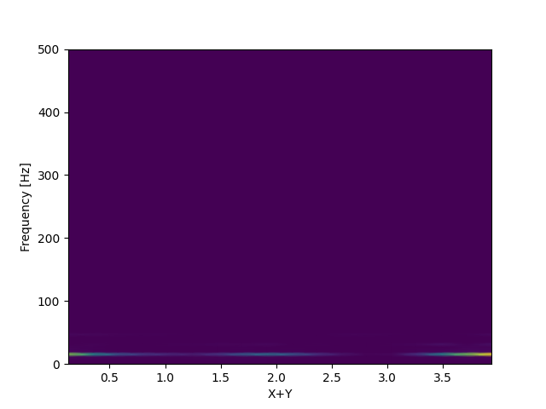
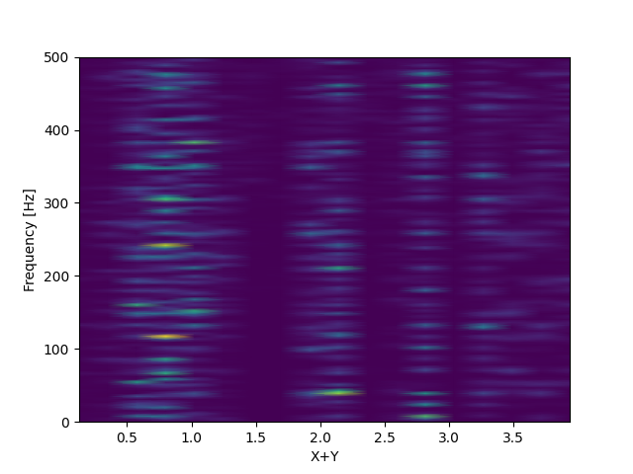
What did I do?
frequency
Signal
noise
v
amp
Low frequency + stationery
High frequency + non-stationery
Find cases
High-frequency + Non-stationary dataset
Prove it works
Applying FRFT to it
$$u\left(s\right)∝\exp\left(−\frac{1}{2}s^{T}Qs\right)$$
$$Q=A^{T}D_{v}A$$
$$A=D_{v}D_{k^{2}}−A_{H}$$
$$A_{H}{∈R}^{MN×MN}$$
When H(s) is a constant,
u(s) is a stationary dataset.
When H(s) has vector fields,
u(s) is a non-stationary dataset.
$$\left(k^{2}−∇H(s)∇\right)u\left(s\right)=W\left(s\right)$$
$$k>0, s∈D=\left[A_{1},B_{1}\right]×\left[A_{2},B_{2}\right] ⊂R^{2},$$
$$∇ =[\frac{∂ }{∂s_{1}},\frac{∂ }{∂s_{2}}]$$
$$H\left(s\right)=function with vector field,$$
$$u\left(s\right)=nonstationary dataset,$$
$$W\left(s\right)=standard gaussian white noise$$
$$H\left(s\right)=γI_{2}+Βv\left(s\right)v{\left(s\right)}^{T},γ,Β>0$$
Gets:
High frequency when s2 goes up
Non-stationary with s2
Ref: Exploring a New Class of Non-stationary Spatial Gaussian Random Fields with Varying Local Anisotropy
Notes:
Implementation shows from the middle screen shot
Get high frequency from high s2 value
Get nonstaionary property from various s2 value
The results show on the top right figure. (y axis: freq, x axis: posion)
Left one includes low freq and stationary signal. (It has high freq but too minor)
Right one include high freq and nonstaionary dataset.

Slide 13


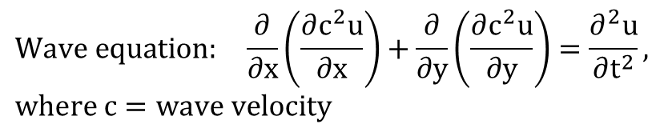
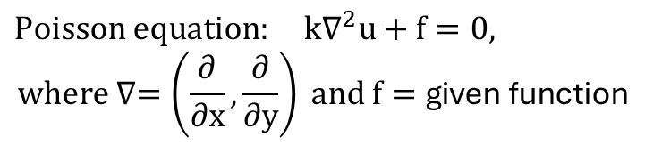
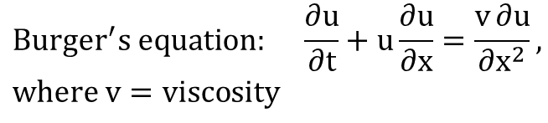

What did I do?
frequency
Signal
noise
v
amp
$$Burger^{′}s equation: \frac{∂u}{∂t}+u\frac{∂u}{∂x}=\frac{v∂u}{∂x^{2}}, where v=viscosity$$
Find cases
High-frequency + Non-stationary dataset
Prove it works
Applying FRFT to it
Goal: u(x,0)-> u(x,t)
$Poisson equation: k∇^{2}u+f=0,$
$$where ∇=\left(\frac{∂}{∂x},\frac{∂}{∂y}\right) and f=\text{given} \text{function}$$
$$a= u\left(x,0\right)$$
$$u=u(x,t)$$
Goal: f(x,y)-> u(x,y)
$$Wave equation: \frac{∂}{∂x}\left(\frac{∂c^{2}u}{∂x}\right)+\frac{∂}{∂y}\left(\frac{∂c^{2}u}{∂y}\right)=\frac{∂^{2}u}{∂t^{2}}, where c=wave velocity$$
Add it as the initial condition
$$u\left(s,0\right)∝\exp\left(−\frac{1}{2}s^{T}Qs\right)$$
Goal: u(x,y,0)-> u(x,y,t)
Notes:
Three cases to test FRFT: Burger, Poisson, and Wave
Goal: map initial condition to specific time state.
Method:
1. Make initial condition a nonstationary dataset
2. Apply initial condition into numerical method to get solution

Slide 14
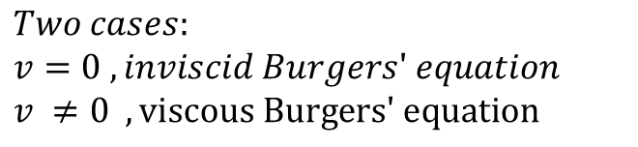
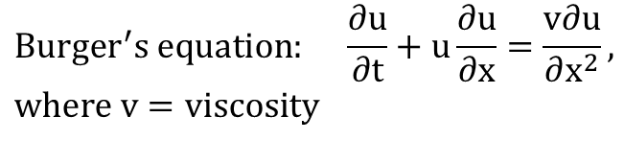
What did I do?
frequency
Signal
noise
v
amp
$$Burger^{′}s equation: \frac{∂u}{∂t}+u\frac{∂u}{∂x}=\frac{v∂u}{∂x^{2}}, where v=viscosity$$
Find cases
High-frequency + Non-stationary dataset
Prove it works
Applying FRFT to it
Goal: u(x,0)-> u(x,t)
$Two cases:$
$v=0 ,inviscid Burgers′ equation$
$v ≠0 , \text{viscous} \text{Burgers}\text{′ }\text{equation}$
$$a= u\left(x,0\right)$$
$$u=u(x,t)$$
Add it as the initial condition
$$u\left(s,0\right)∝\exp\left(−\frac{1}{2}s^{T}Qs\right)$$
Notes:
Two cases in Burger: v=0 and v!=0

Slide 15

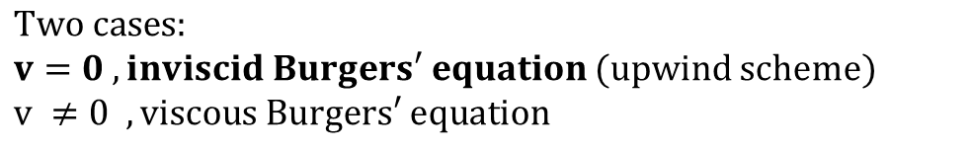
What did I do?
frequency
Signal
noise
v
amp
$$Burger^{′}s equation: \frac{∂u}{∂t}+u\frac{∂u}{∂x}=\frac{v∂u}{∂x^{2}}, where v=viscosity$$
Find cases
High-frequency + Non-stationary dataset
Prove it works
Applying FRFT to it
Goal: u(x,0)-> u(x,t)
$Two cases:$
$v=0 ,inviscid Burgers′ equation$ (upwind scheme)
$v ≠0 , \text{viscous} \text{Burgers}\text{′ }\text{equation}$
$\frac{∂u}{∂t}+u\frac{∂u}{∂x}=0, introduce f\left(u\right)=\frac{u^{2}}{2}$
$⇒\frac{∂u}{∂t}+\frac{∂f}{∂u}\frac{∂u}{∂x}=0$
$⇒\frac{∂u}{∂t}+\frac{∂f}{∂x}=0$
$⇒\frac{u_{j}^{n+1}{−u}_{j}^{n}}{Δt}=\frac{{f(u}_{j}^{n}){−f(u}_{j+1}^{n})}{Δx}$ ,
Where n: time point, and j: x points
$$a= u\left(x,0\right)$$
$$u=u(x,t)$$
Add it as the initial condition
$$u\left(s,0\right)∝\exp\left(−\frac{1}{2}s^{T}Qs\right)$$
Ref: https://github.com/gilbertfrancois/partial-differential-equations/blob/master/notebook/1D%20Burgers%27%20equation%2C%20finite%20volume%2C%20upwind%20scheme.ipynb
Notes:
V=0: using upwind scheme as numerical method
Method:
Introduce f = u*u/2
Express equation with f
Express equation by approximation format
Get solution by scipy integral tool

Slide 16
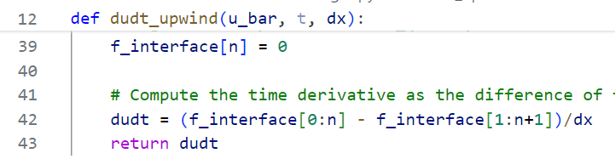
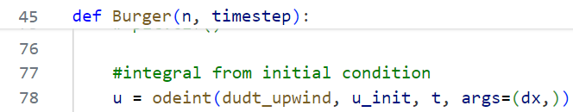
What did I do?
frequency
Signal
noise
v
amp
$$Burger^{′}s equation: \frac{∂u}{∂t}+u\frac{∂u}{∂x}=\frac{v∂u}{∂x^{2}}, where v=viscosity$$
Find cases
High-frequency + Non-stationary dataset
Prove it works
Applying FRFT to it
Goal: u(x,0)-> u(x,t)
$Two cases:$
$v=0 ,inviscid Burgers′ equation$ (upwind scheme)
$v ≠0 , \text{viscous} \text{Burgers}\text{′ }\text{equation}$
$\frac{∂u}{∂t}+u\frac{∂u}{∂x}=0, introduce f\left(u\right)=\frac{u^{2}}{2}$
$⇒\frac{∂u}{∂t}+\frac{∂f}{∂u}\frac{∂u}{∂x}=0$
$⇒\frac{∂u}{∂t}+\frac{∂f}{∂x}=0$
$⇒\frac{u_{j}^{n+1}{−u}_{j}^{n}}{Δt}=\frac{{f(u}_{j}^{n}){−f(u}_{j+1}^{n})}{Δx}$ ,
Where n: time point, and j: x points
$$a= u\left(x,0\right)$$
$$u=u(x,t)$$
Add it as the initial condition
$$u\left(s,0\right)∝\exp\left(−\frac{1}{2}s^{T}Qs\right)$$
Ref: https://github.com/gilbertfrancois/partial-differential-equations/blob/master/notebook/1D%20Burgers%27%20equation%2C%20finite%20volume%2C%20upwind%20scheme.ipynb

Slide 17
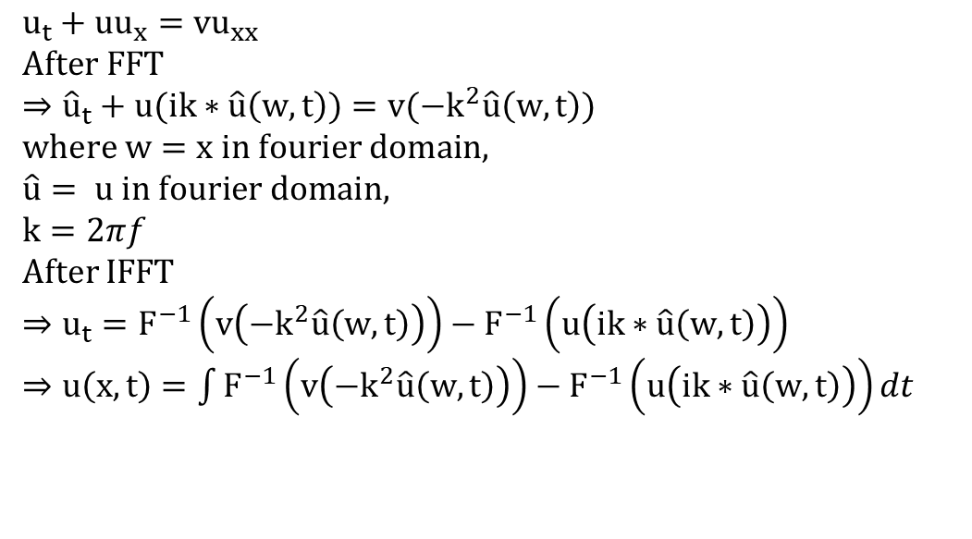
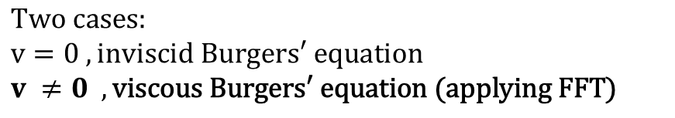
What did I do?
frequency
Signal
noise
v
amp
$$Burger^{′}s equation: \frac{∂u}{∂t}+u\frac{∂u}{∂x}=\frac{v∂u}{∂x^{2}}, where v=viscosity$$
Find cases
High-frequency + Non-stationary dataset
Prove it works
Applying FRFT to it
Goal: u(x,0)-> u(x,t)
$Two cases:$
$v=0 ,inviscid Burgers′ equation$
$v ≠0 , \text{viscous} \text{Burgers}\text{′ }\text{equation}\text{ (}\text{applying} \text{FFT}\text{)}$
$u_{t}+uu_{x}=vu_{xx}$
$After FFT$
$⇒{\hat{u}}_{t}+u(ik∗\hat{u}\left(w,t\right))=v({−k}^{2}\hat{u}\left(w,t\right))$
$where w=x in fourier domain,$
$\hat{u}= u in fourier domain,$
$k=2πf$
After IFFT
$⇒u_{t}=F^{−1}\left(v\left({−k}^{2}\hat{u}\left(w,t\right)\right)\right)−F^{−1}\left(u\left(ik∗\hat{u}\left(w,t\right)\right)\right)$
$⇒u\left(x,t\right)=\int{F^{−1}\left(v\left({−k}^{2}\hat{u}\left(w,t\right)\right)\right)−F^{−1}\left(u\left(ik∗\hat{u}\left(w,t\right)\right)\right)dt}$
$$a= u\left(x,0\right)$$
$$u=u(x,t)$$
Add it as the initial condition
$$u\left(s,0\right)∝\exp\left(−\frac{1}{2}s^{T}Qs\right)$$
Ref: https://github.com/sachabinder/Burgers_equation_simulation/blob/main/Burgers_solver_SP.py
Notes:
V!=0: using fft to get numerical result
Turn equation into Fourier domain
Organize equation
Turn equation back to regular domain
Solve integral by scipy tool

Slide 18
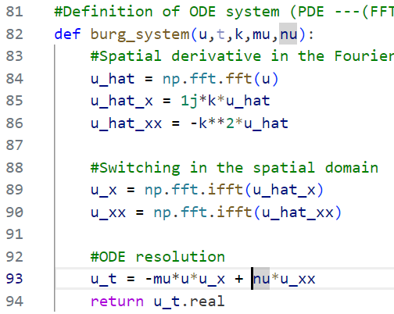
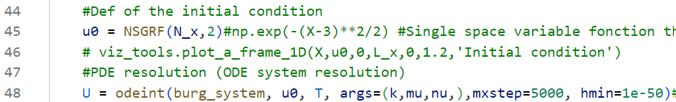
What did I do?
frequency
Signal
noise
v
amp
$$Burger^{′}s equation: \frac{∂u}{∂t}+u\frac{∂u}{∂x}=\frac{v∂u}{∂x^{2}}, where v=viscosity$$
Find cases
High-frequency + Non-stationary dataset
Prove it works
Applying FRFT to it
Goal: u(x,0)-> u(x,t)
$Two cases:$
$v=0 ,inviscid Burgers′ equation$
$v ≠0 , \text{viscous} \text{Burgers}\text{′ }\text{equation}\text{ (}\text{applying} \text{FFT}\text{)}$
$u_{t}+uu_{x}=vu_{xx}$
$After FFT$
$⇒{\hat{u}}_{t}+u(ik∗\hat{u}\left(w,t\right))=v({−k}^{2}\hat{u}\left(w,t\right))$
$where w=x in fourier domain,$
$\hat{u}= u in fourier domain,$
$k=2πf$
After IFFT
$⇒u_{t}=F^{−1}\left(v\left({−k}^{2}\hat{u}\left(w,t\right)\right)\right)−F^{−1}\left(u\left(ik∗\hat{u}\left(w,t\right)\right)\right)$
$⇒u\left(x,t\right)=\int{F^{−1}\left(v\left({−k}^{2}\hat{u}\left(w,t\right)\right)\right)−F^{−1}\left(u\left(ik∗\hat{u}\left(w,t\right)\right)\right)dt}$
$$a= u\left(x,0\right)$$
$$u=u(x,t)$$
Add it as the initial condition
$$u\left(s,0\right)∝\exp\left(−\frac{1}{2}s^{T}Qs\right)$$
Ref: https://github.com/sachabinder/Burgers_equation_simulation/blob/main/Burgers_solver_SP.py

Slide 19
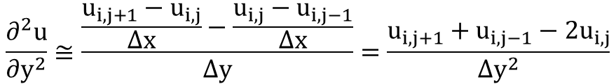
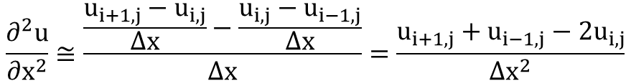
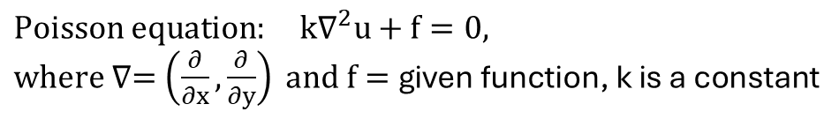
What did I do?
frequency
Signal
noise
v
amp
$Poisson equation: k∇^{2}u+f=0,$
$where ∇=\left(\frac{∂}{∂x},\frac{∂}{∂y}\right) and f=\text{given} \text{function}\text{, }\text{k} \text{is} \text{a} \text{constant}$
Find cases
High-frequency + Non-stationary dataset
Prove it works
Applying FRFT to it
Goal: f(x,y)-> u(x,y)
Applying finite difference method:
$$\frac{∂^{2}u}{∂x^{2}}≅\frac{\frac{u_{i+1,j}−u_{i,j}}{Δx}−\frac{u_{i,j}−u_{i−1,j}}{Δx}}{Δx}=\frac{u_{i+1,j}+u_{i−1,j}−2u_{i,j}}{Δx^{2}}$$
$$a= u\left(x,0\right)$$
$$\frac{∂^{2}u}{∂y^{2}}≅\frac{\frac{u_{i,j+1}−u_{i,j}}{Δx}−\frac{u_{i,j}−u_{i,j−1}}{Δx}}{Δy}=\frac{u_{i,j+1}+u_{i,j−1}−2u_{i,j}}{Δy^{2}}$$
$$u=u(x,t)$$
Add it as the initial condition
Au = -f, where
A= derivative matrix, u=solution, -f = given function
$$u\left(s,0\right)∝\exp\left(−\frac{1}{2}s^{T}Qs\right)$$
Ref: https://github.com/gilbertfrancois/partial-differential-equations/blob/master/notebook/2D%20Poisson%20equation%2C%20finite%20difference.ipynb
Notes:
Using finite difference method to get numerical result
Method:
Express equation as approximation format
Simplify equations
Get derivative matrix from partial differential part. (A)
It is a matrix with some items: 1/deltax*deltax, 1/deltay*deltay, -2/deltax*deltax, and -2/deltay*deltay
4. Get solution by numpy tool. (-f * inverse(A))

Slide 20
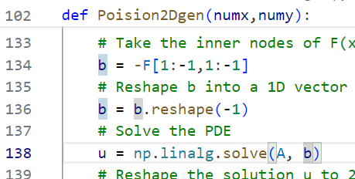
What did I do?
frequency
Signal
noise
v
amp
$Poisson equation: k∇^{2}u+f=0,$
$where ∇=\left(\frac{∂}{∂x},\frac{∂}{∂y}\right) and f=\text{given} \text{function}\text{, }\text{k} \text{is} \text{a} \text{constant}$
Find cases
High-frequency + Non-stationary dataset
Prove it works
Applying FRFT to it
Goal: f(x,y)-> u(x,y)
Applying finite difference method:
$$\frac{∂^{2}u}{∂x^{2}}≅\frac{\frac{u_{i+1,j}−u_{i,j}}{Δx}−\frac{u_{i,j}−u_{i−1,j}}{Δx}}{Δx}=\frac{u_{i+1,j}+u_{i−1,j}−2u_{i,j}}{Δx^{2}}$$
$$a= u\left(x,0\right)$$
$$\frac{∂^{2}u}{∂y^{2}}≅\frac{\frac{u_{i,j+1}−u_{i,j}}{Δx}−\frac{u_{i,j}−u_{i,j−1}}{Δx}}{Δy}=\frac{u_{i,j+1}+u_{i,j−1}−2u_{i,j}}{Δy^{2}}$$
$$u=u(x,t)$$
Add it as the initial condition
Au = -f, where
A= derivative matrix, u=solution, -f = given function
$$u\left(s,0\right)∝\exp\left(−\frac{1}{2}s^{T}Qs\right)$$
Ref: https://github.com/gilbertfrancois/partial-differential-equations/blob/master/notebook/2D%20Poisson%20equation%2C%20finite%20difference.ipynb

Slide 21

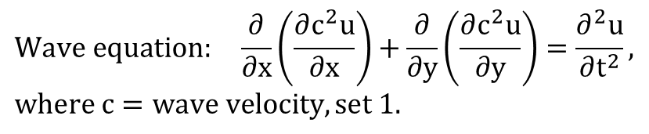
What did I do?
frequency
Signal
noise
v
amp
$$Wave equation: \frac{∂}{∂x}\left(\frac{∂c^{2}u}{∂x}\right)+\frac{∂}{∂y}\left(\frac{∂c^{2}u}{∂y}\right)=\frac{∂^{2}u}{∂t^{2}}, where c=wave velocity, set 1.$$
Find cases
High-frequency + Non-stationary dataset
Prove it works
Applying FRFT to it
Goal: u(x,y,0)-> u(x,y,t)
Applying finite difference method to solve it
$\frac{∂^{2}u}{∂t^{2}}=\frac{∂^{2}u}{∂x^{2}}+\frac{∂^{2}u}{∂y^{2}}$
$⇒\frac{u_{i,j}^{t+1}+u_{i,j}^{t−1}−2u_{i,j}^{t}}{Δt^{2}}=\frac{u_{i+1,j}^{t}+u_{i−1,j}^{t}−2u_{i,j}^{t}}{Δx^{2}}$+ $\frac{u_{i,j+1}^{t}+u_{i,j−1}^{t}−2u_{i,j}^{t}}{Δy^{2}}$
$⇒u_{i,j}^{t+1}={2u}_{i,j}^{t}−u_{i,j}^{t−1}+\frac{Δt^{2}}{Δx^{2}}\left(u_{i+1,j}^{t}+u_{i−1,j}^{t}−2u_{i,j}^{t}\right)+$
$\frac{Δt^{2}}{Δy^{2}}\left(u_{i,j+1}^{t}+u_{i,j−1}^{t}−2u_{i,j}^{t}\right)$
Adding initial velocity(v) when t=1(some applications might need)
$⇒u_{i,j}^{t+1}={2u}_{i,j}^{t}−u_{i,j}^{t−1}−2Δtv_{i,j}+\frac{Δt^{2}}{Δx^{2}}\left(u_{i+1,j}^{t}+u_{i−1,j}^{t}−2u_{i,j}^{t}\right)+$
$\frac{Δt^{2}}{Δy^{2}}\left(u_{i,j+1}^{t}+u_{i,j−1}^{t}−2u_{i,j}^{t}\right)$
$$a= u\left(x,0\right)$$
$$u=u(x,t)$$
Add it as the initial condition
$$u\left(s,0\right)∝\exp\left(−\frac{1}{2}s^{T}Qs\right)$$
Ref: https://github.com/sachabinder/wave_equation_simulations/blob/main/2D_WAVE-EQ_variable-velocity.py
Notes:
Using finite difference method to get numerical result
Method:
Express equation to approximation format
Organize it
Get next time state by current and previous state

Slide 22
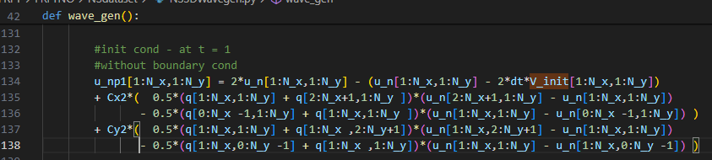


What did I do?
frequency
Signal
noise
v
amp
$$Wave equation: \frac{∂}{∂x}\left(\frac{∂c^{2}u}{∂x}\right)+\frac{∂}{∂y}\left(\frac{∂c^{2}u}{∂y}\right)=\frac{∂^{2}u}{∂t^{2}}, where c=wave velocity, set 1.$$
Find cases
High-frequency + Non-stationary dataset
Prove it works
Applying FRFT to it
Goal: u(x,y,0)-> u(x,y,t)
Applying finite difference method to solve it
$\frac{∂^{2}u}{∂t^{2}}=\frac{∂^{2}u}{∂x^{2}}+\frac{∂^{2}u}{∂y^{2}}$
$⇒\frac{u_{i,j}^{t+1}+u_{i,j}^{t−1}−2u_{i,j}^{t}}{Δt^{2}}=\frac{u_{i+1,j}^{t}+u_{i−1,j}^{t}−2u_{i,j}^{t}}{Δx^{2}}$+ $\frac{u_{i,j+1}^{t}+u_{i,j−1}^{t}−2u_{i,j}^{t}}{Δy^{2}}$
$⇒u_{i,j}^{t+1}={2u}_{i,j}^{t}−u_{i,j}^{t−1}+\frac{Δt^{2}}{Δx^{2}}\left(u_{i+1,j}^{t}+u_{i−1,j}^{t}−2u_{i,j}^{t}\right)+$
$\frac{Δt^{2}}{Δy^{2}}\left(u_{i,j+1}^{t}+u_{i,j−1}^{t}−2u_{i,j}^{t}\right)$
Adding initial velocity(v) when t=1(some applications might need)
$⇒u_{i,j}^{t+1}={2u}_{i,j}^{t}−u_{i,j}^{t−1}−2Δtv_{i,j}+\frac{Δt^{2}}{Δx^{2}}\left(u_{i+1,j}^{t}+u_{i−1,j}^{t}−2u_{i,j}^{t}\right)+$
$\frac{Δt^{2}}{Δy^{2}}\left(u_{i,j+1}^{t}+u_{i,j−1}^{t}−2u_{i,j}^{t}\right)$
$$a= u\left(x,0\right)$$
$$u=u(x,t)$$
Add it as the initial condition
$$u\left(s,0\right)∝\exp\left(−\frac{1}{2}s^{T}Qs\right)$$
Ref: https://github.com/sachabinder/wave_equation_simulations/blob/main/2D_WAVE-EQ_variable-velocity.py
https://hplgit.github.io/num-methods-for-PDEs/doc/pub/wave/pdf/wave-4print-A4-2up.pdf
Notes:
q[I,j] is wave velocity, which is 1 everywhere
V_init is wave initial velocity, only add in the beginning and is removed after t>1

Slide 23





What did I do?
frequency
Signal
noise
v
amp
Find cases
High-frequency + Non-stationary dataset
Prove it works
Applying FRFT to it
a(x)
P
FRFT layer1
…
Q
u(x)
FRFT layer 4
Based on
FNO architecture
$$F^{α}$$
All information
$$R(θ)$$
All information
$$F^{−α}$$
FRFT layer
+
$$σ$$
$$W$$
Ref: Fourier Neural Operator for Parametric Partial Differential Equations
Notes:
Build model:
Replace Fourier layer into FRFT
Get all information rather truncation
Learn alpha by neural network
Learn weights by neural network

Slide 24
Outline
Problem definition
Motivation
What did I do?
Result
Conclusion

Slide 25
Result - burger’s equation
Test l2 error | V=0 | V=0.001
Train 1& Test 1 | 0.069647 | 0.032559
Train 2 & Test 2 | 0.064908 | 0.031946
Train 3 & Test 3 | 0.067103 | 0.0264
Train 4 & Test 4 | 0.055544 | 0.026487
FRFTNO avg. | 0.064300 | 0.029348
A: Fourier layer, B: FRFT layer
Architecture: AABB(v=0), ABBB(v=0.001)
Dataset size 200
Test sequence:
Train1:dataset[:30], Test1: dataset[-100:]
Train2 dataset[30:60], Test2 dataset[-100:]
Train3 dataset[60:90], Test3 dataset[-100:]
Train4 dataset[-30:], Test 4 dataset[:100]
Test l2 error | V=0 | V=0.001
Train 1& Test 1 | 0.083705 | 0.045617
Train 2 & Test 2 | 0.089063 | 0.045515
Train 3 & Test 3 | 0.082765 | 0.048091
Train 4 & Test 4 | 0.09321 | 0.04524
FNO all modes avg. | 0.087186 | 0.046116
Notes:
Build 200 datasets
Train and test model by different part of datasets
Good performance no matter in vicious(36%) or inviscid cases(26%).

Slide 26
Result - poisson’s equation
Test l2 error
Train 1& Test 1 | 0.371117
Train 2 & Test 2 | 0.354186
Train 3 & Test 3 | 0.334832
Train 4 & Test 4 | 0.355024
FRFTNO avg. | 0.353790
A: Fourier layer, B: FRFT layer
Architecture: BAAA
Dataset size 200
Test sequence:
Train1:dataset[:30], Test1: dataset[-100:]
Train2 dataset[30:60], Test2 dataset[-100:]
Train3 dataset[60:90], Test3 dataset[-100:]
Train4 dataset[-30:], Test 4 dataset[:100]
Test l2 error
Train 1& Test 1 | 0.448968
Train 2 & Test 2 | 0.449978
Train 3 & Test 3 | 0.444467
Train 4 & Test 4 | 0.445845
FNO all modes avg. | 0.447315
Notes:
Build 200 datasets
Train and test model by different part of datasets
Good performance, around 21%.

Slide 27
Result - wave’s equation
Test l2 error | V=0 | V=0.001
Train 1& Test 1 | 0.06064 | 0.062344
Train 2 & Test 2 | 0.060401 | 0.060734
Train 3 & Test 3 | 0.061143 | 0.060232
Train 4 & Test 4 | 0.059051 | 0.063212
FRFTNO avg | 0.06031 | 0.061631
A: Fourier layer, B: FRFT layer
Architecture: BAAB(V=0), BBAB(V=0.001)
Dataset size 200
Test sequence:
Train1:dataset[:30], Test1: dataset[-100:]
Train2 dataset[30:60], Test2 dataset[-100:]
Train3 dataset[60:90], Test3 dataset[-100:]
Train4 dataset[-30:], Test 4 dataset[:100]
Test l2 error | V=0 | V=0.001
Train 1& Test 1 | 0.07214 | 0.067753
Train 2 & Test 2 | 0.069251 | 0.07335
Train 3 & Test 3 | 0.073995 | 0.072818
Train 4 & Test 4 | 0.072781 | 0.070534
FNO all modes avg. | 0.072042 | 0.071114
Notes:
Build 200 datasets
Train and test model by different part of datasets
Good performance on no initial speed(16%) and 0.001 initial speed(13%)
Gaps are close because initial speed is a linear part in numerical method.

Slide 28
Result - FNO vanilla
Burger Test l2 error | V=0 | V=0.001
Train 1& Test 1 | 0.335549 | 0.371378
Train 2 & Test 2 | 0.335588 | 0.370999
Train 3 & Test 3 | 0.335466 | 0.371433
Train 4 & Test 4 | 0.332224 | 0.36674
FNO all modes avg. | 0.334707 | 0.370138
Poisson Test l2 error
Train 1& Test 1 | 0.771226
Train 2 & Test 2 | 0.792926
Train 3 & Test 3 | 0.750082
Train 4 & Test 4 | 0.795369
FNO all modes avg. | 0.777400
Wave Test l2 error | V=0 | V=0.001
Train 1& Test 1 | 0.083385 | 0.084923
Train 2 & Test 2 | 0.08481 | 0.084671
Train 3 & Test 3 | 0.083464 | 0.084933
Train 4 & Test 4 | 0.082462 | 0.082445
FRFTNO avg | 0.083530 | 0.084243

Slide 29
Outline
Problem definition
Motivation
What did I do?
Result
Conclusion

Slide 30
Conclusion
High-frequency dataset
Non-stationary dataset
Fractional Fourier transform
Future work: Linear canonical transform??
Notes:
This project introduce three things:
High frequency dataset
Non stationary dataset
FRFT is better than FFT in these cases
Future work:
Linear canonical transform is a general form for FRFT
It can do more reshape to signal on freq-time domain.

Slide 31



Result – by manual
$$Burger^{′}s equation: \frac{∂u}{∂t}+u\frac{∂u}{∂x}=\frac{v∂u}{∂x^{2}}, where v=vecosity$$
$$Poisson equation: k∇^{2}u+f=0, where ∇=\left(\frac{∂}{∂x},\frac{∂}{∂y}\right) and f=\text{given} \text{function}$$
$$Wave equation: \frac{∂}{∂x}\left(\frac{∂c^{2}u}{∂x}\right)+\frac{∂}{∂y}\left(\frac{∂c^{2}u}{∂y}\right)=\frac{∂^{2}u}{∂t^{2}}, where c=wave velocity$$
Burger equation | Train error(v=0) | Test error(v=0) | Train error(v=0.001) | Test error(v=0.001)
FNO | 0.001452013 | 0.08370549 | 0.005017 | 0.045617
FRFTNO | 0.012690056 | 0.055142305 | 0.011902 | 0.035232
Poisson equation | Train | Test
FNO | 0.000364 | 0.448968
FRFTNO | 0.004806 | 0.352961
Wave equation v = initial speed | Train(v=0) | Test(v=0) | Train(v=0.001) | Test(v=0.001)
FNO | 0.050162 | 0.07214 | 0.048058 | 0.067753
FRFTNO | 0.050384 | 0.066653 | 0.046522 | 0.065375
At least, It works!

Slide 32
Burger equation
V: viscosity | V = 0 |  | V=0.001
500 epochs train N:30 test N:100 | Train | Test | Train | Test
FNO all mode 1 layer | 0.013424099 | 0.050683396 | 0.010348 | 0.035222
FNO all mode 2 layers | 0.002530336 | 0.075994416 | 0.005837 | 0.042177
FNO all mode 3 layers | 0.001308373 | 0.080793696 | 0.004668 | 0.043666
FNO all mode 4 layers | 0.001452013 | 0.08370549 | 0.005017 | 0.045617
FRFT 2 layers | 0.013170323 | 0.058556114 | 0.011052 | 0.036548
FRFT 3 layers | 0.013010737 | 0.055940504 | 0.011958 | 0.037162
FRFT 4 layers | 0.012690056 | 0.055142305 | 0.011902 | 0.035232

Slide 33
Poisson equation
 | Train | Test
FNO all mode 1 layer | 0.039793 | 0.853731
FNO all mode 2 layers | 0.00142 | 0.486432
FNO all mode 3 layers | 0.000299 | 0.459118
FNO all mode 4 layers | 0.000364 | 0.448968
FRFT 1 layers | 0.002698 | 0.717565
FRFT 2 layers | 0.001437 | 0.419202
FRFT 3 layers | 0.001727 | 0.379013
FRFT 4 layers | 0.004806 | 0.352961

Slide 34
Wave equation
V: initial speed | V = 0 |  | V=0.001
500 epochs train N:30 test N:100 | Train | Test | Train | Test
FNO all mode 1 layer | 0.04739 | 0.074811 | 0.046195 | 0.072238
FNO all mode 2 layers | 0.04586 | 0.080324 | 0.042334 | 0.078217
FNO all mode 3 layers | 0.046018 | 0.076723 | 0.044265 | 0.073412
FNO all mode 4 layers | 0.050162 | 0.07214 | 0.048058 | 0.067753
FRFT 2 layers | 0.039215 | 0.065856 | 0.042377 | 0.067792
FRFT 3 layers | 0.043247 | 0.062376 | 0.039679 | 0.061649
FRFT 4 layers | 0.050384 | 0.066653 | 0.046522 | 0.065375

